Slide 1

Kill Mo’ Chicken
Team 5 Guys

Slide 2



Notes:
In a world where farmyard alliances hang by a thread, a battle rages between two unlikely foes: the noble cows and the cunning chickens. This tower defense game unfolds in the lush fields of Pastoria, where the serene life of grazing and pecking is shattered by an insatiable hunger for survival.
As the sun rises over the golden pastures, the cows gather for a council. Once content to roam freely, they face a grim reality: their numbers dwindle while the appetite for chicken falls. A desperate plan emerges—convince the human population to indulge in more chicken, hoping to divert the threat from their own kind. But the crafty chickens, realizing their impending doom, rally together, determined to defend their place on the dinner plate.

Slide 3
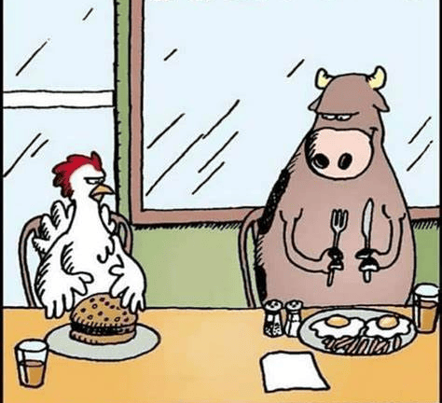
Story
An ancient war has been brewing since the beginning of time, Cows vs Chickens. Their conflict never ending, based on a desperate plan from the cows, convince the human population to indulge in more chicken, hoping to divert the threat from their own kind
Notes:
This tower defense game unfolds in the lush fields of Pastoria, where the serene life of grazing and pecking is shattered by an insatiable hunger for survival.
As the sun rises over the golden pastures, the cows gather for a council. Once content to roam freely, they face a grim reality: their numbers dwindle while the appetite for chicken falls. A desperate plan emerges—convince the human population to indulge in more chicken, hoping to divert the threat from their own kind.
But the crafty chickens, realizing their impending doom, rally together, determined to defend their place on the dinner plate. Players are thrust into this conflict, commanding the courageous cows who must build defenses, create strategic formations, and utilize an arsenal of dairy-inspired weaponry.
From fortified barns to mooo-tary towers that unleash milk grenades, the cows will stop at nothing to spread their message: "Eat more chicken!" Yet, the chickens, equipped with feathered tactics and relentless speed, retaliate with their own arsenal—egg bombs and clucky distractions—to thwart the cows' efforts.
The stakes are high as players navigate the intricate balance between defense and persuasion, setting up traps and upgrading their defenses while trying to sway the humans to their cause. As waves of chickens charge, players must strategize, adapt, and fight to protect their bovine brethren.
Will the cows succeed in their mission to shift the tides of culinary preference, or will the chickens rise triumphant, defending their legacy from the clutches of the dinner table? The fate of Pastoria hangs in the balance, and only the boldest will prevail in this epic clash of clucks and moo

Slide 4
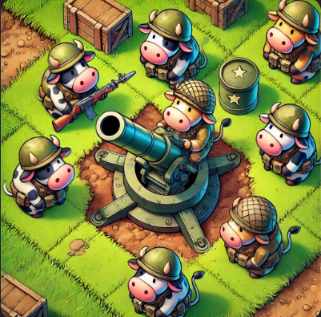
Story
This tower defense game unfolds in the lush fields of Pastoria. Where Players are thrust into this conflict, commanding the courageous cows who must build defenses, create strategic formations, and utilize an arsenal of dairy-inspired weaponry.
Notes:
This tower defense game unfolds in the lush fields of Pastoria, where the serene life of grazing and pecking is shattered by an insatiable hunger for survival.
As the sun rises over the golden pastures, the cows gather for a council. Once content to roam freely, they face a grim reality: their numbers dwindle while the appetite for chicken falls. A desperate plan emerges—convince the human population to indulge in more chicken, hoping to divert the threat from their own kind.
But the crafty chickens, realizing their impending doom, rally together, determined to defend their place on the dinner plate. Players are thrust into this conflict, commanding the courageous cows who must build defenses, create strategic formations, and utilize an arsenal of dairy-inspired weaponry.
From fortified barns to mooo-tary towers that unleash milk grenades, the cows will stop at nothing to spread their message: "Eat more chicken!" Yet, the chickens, equipped with feathered tactics and relentless speed, retaliate with their own arsenal—egg bombs and clucky distractions—to thwart the cows' efforts.
The stakes are high as players navigate the intricate balance between defense and persuasion, setting up traps and upgrading their defenses while trying to sway the humans to their cause. As waves of chickens charge, players must strategize, adapt, and fight to protect their bovine brethren.
Will the cows succeed in their mission to shift the tides of culinary preference, or will the chickens rise triumphant, defending their legacy from the clutches of the dinner table? The fate of Pastoria hangs in the balance, and only the boldest will prevail in this epic clash of clucks and moo

Slide 5
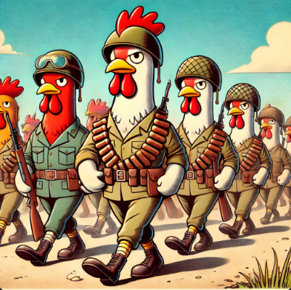
Story
Build, upgrade, and fight As waves of chickens charge, the player must strategize, adapt, and fight to protect their bovine brethren.
Will the cows succeed in their mission to shift the tides of culinary preference, or will the chickens rise triumphant, defending their legacy from the clutches of the dinner table?
Notes:
The stakes are high as players navigate the intricate balance between defense and persuasion, setting up traps and upgrading their defenses while trying to sway the humans to their cause. As waves of chickens charge, players must strategize, adapt, and fight to protect their bovine brethren.
Will the cows succeed in their mission to shift the tides of culinary preference, or will the chickens rise triumphant, defending their legacy from the clutches of the dinner table? The fate of Pastoria hangs in the balance, and only the boldest will prevail in this epic clash of clucks and moo

Slide 6
Storyboard

Slide 7
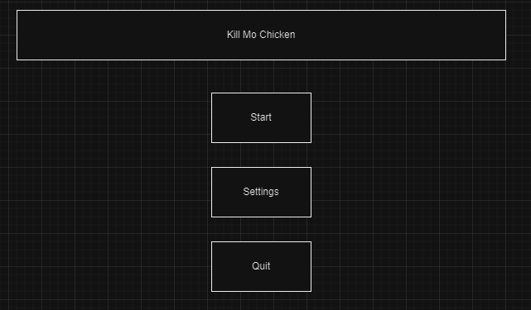
Start Menu
Dialog: None
Action: Upon Opening the game, the user will be able to choose from 3 options, Start, Settings, and Quit
Note: 2D menu, background music

Slide 8
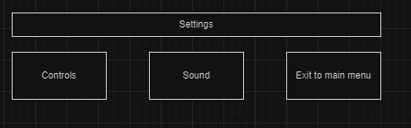
Settings Menu
Dialog: None
Action: In the menu screen, the user is prompted with a settings button, this menu will allow the user to understand the controls and change the music settings
Note: 2D menu, background music

Slide 9
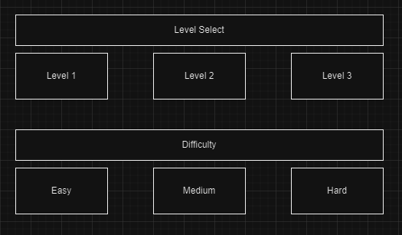
Level Selector
Dialog: None
Action: The user will be prompted with levels that they are able to choose from, and the difficulty they want.
Note: 2D menu, background music

Slide 10
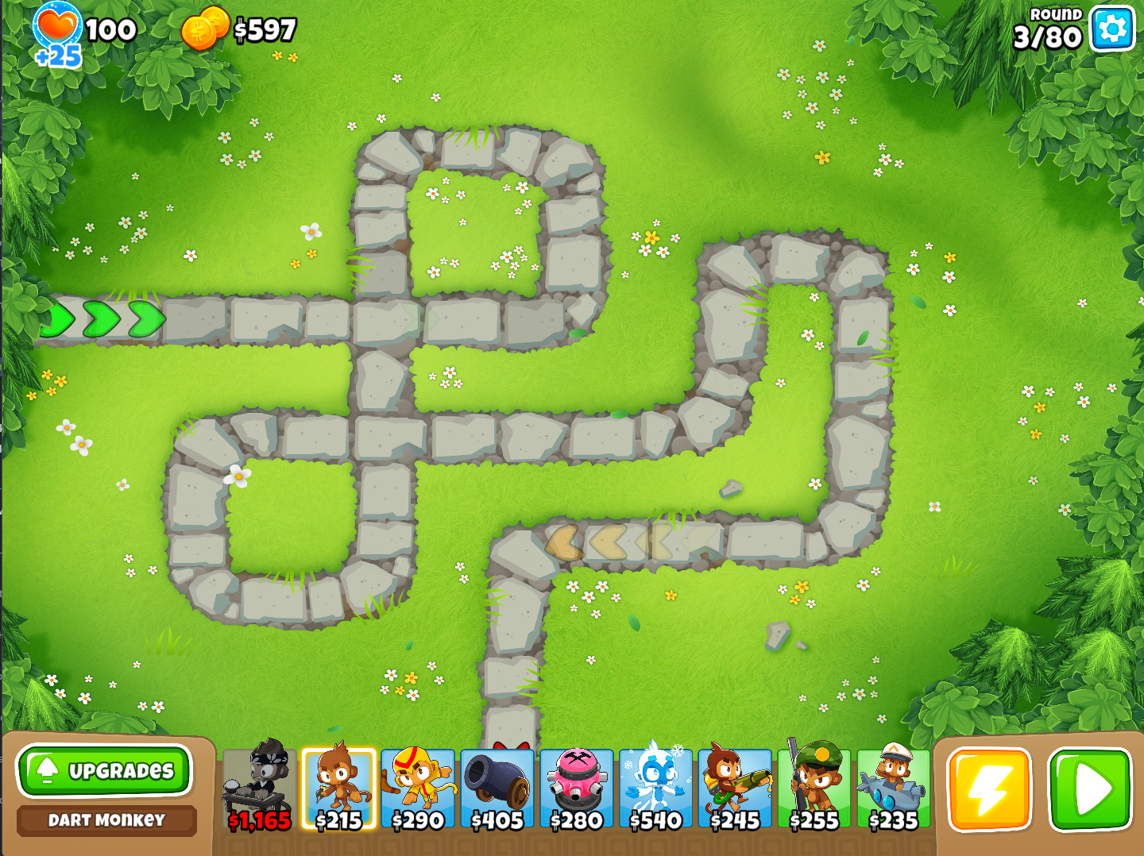
Map and UI
Dialog: None
Action: Upon loading into the game the player is presented with a map. In the image you can see a path, player health, currency(to buy towers), a way to pause the game, and a way to select towers.
Note: (Source: BTD 6) / Top down, background music

Slide 11
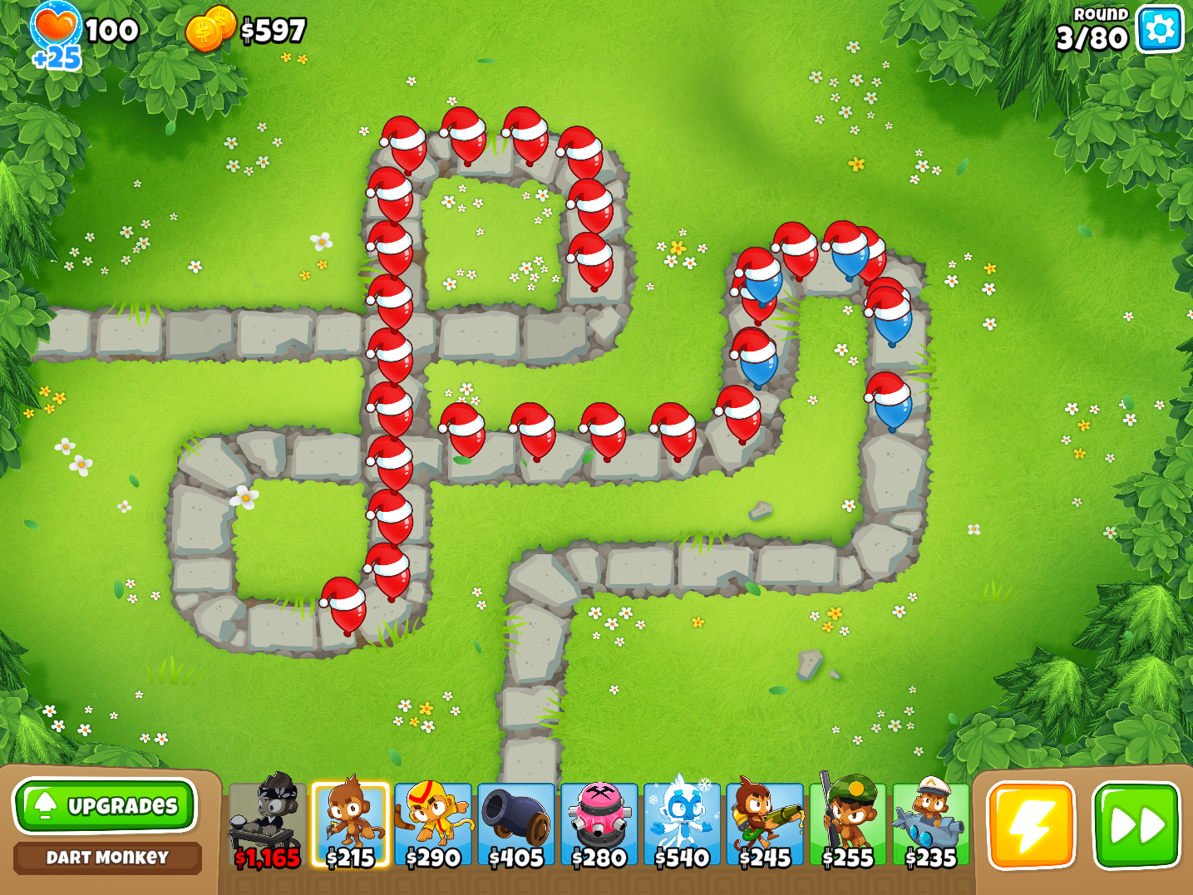
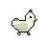
Enemy pathing
Dialog: None
Action: When the game is started, the enemy will begin to move along the designated path. Notice that the different enemy tiers move at different speeds along the path.
Note: (Source: BTD 6) / Top down, background music

Slide 12
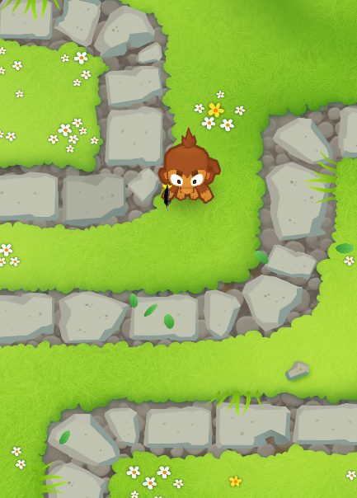
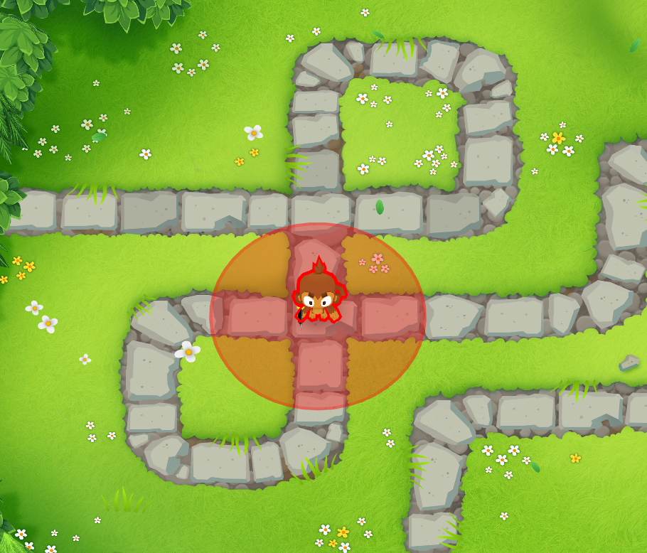
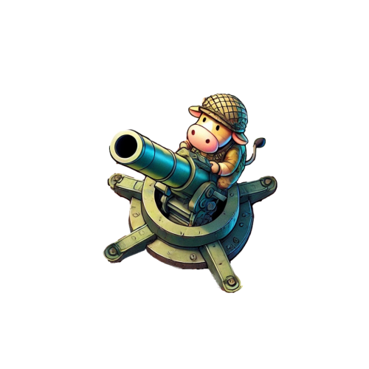
Tower Placement
Dialog: None
Action: For tower placement, the player will not be allowed to put the towers on the path of the balloon, but will be allowed to place them anywhere else. Each tower will also have a certain range they can attack within
Note: (Source: BTD 6) / Top down, background music

Slide 13
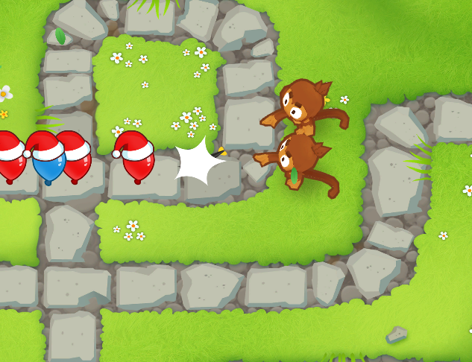
Defeating enemies
Dialog: None
Action: When enemies get within range of the towers, they attack the enemies, and when they reach 0 health they are eliminated and disappear from screen no longer posing a threat.
Note: (Source: BTD 6) / Top down, background music

Slide 14
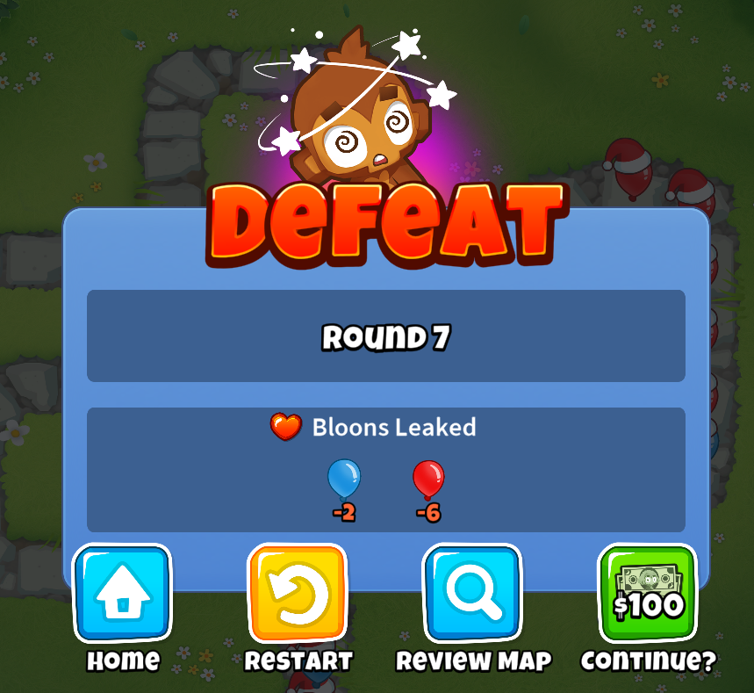


Losing / winning
Dialog: "You lose" / "You win"
Action: When the player loses, they are faced with a screen allowing options for main menu, and restart. (The features we will be using) The other image refers to the round that would need to be completed to beat the level, and the icon for in game settings.
Note: (Source: BTD 6) / Top down, loss / win sound

Slide 15

Project Details

Slide 16
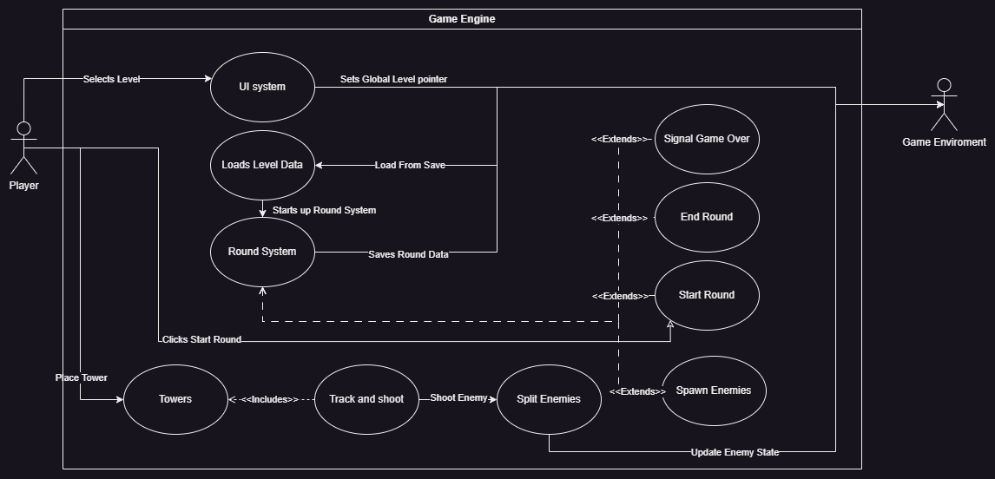
Global Use case

Slide 17
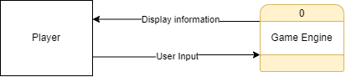
Context Diagram

Slide 18
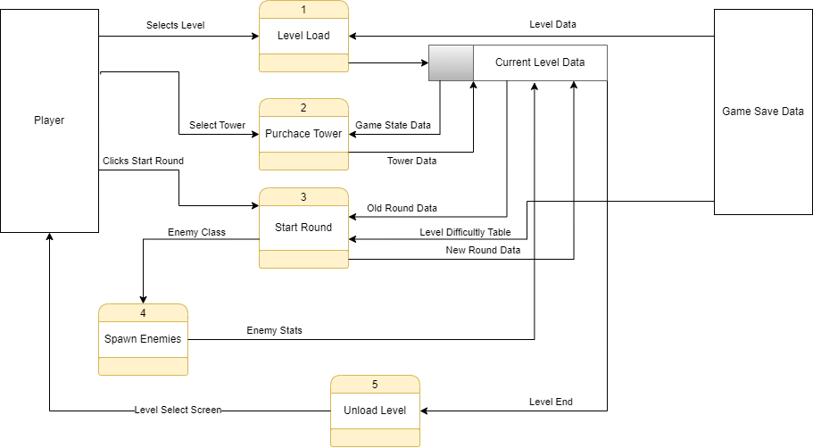
Diagram 0

Slide 19
Levels
Austin TL2

Slide 20
Overview
Map Design
Level Data
Tower Placement Zones
Player Data
Map
Current Round
Priority: High
Complexity: Medium
Austin TL2

Slide 21
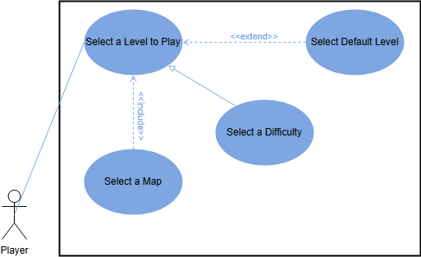
Use Case
Austin TL2

Slide 22
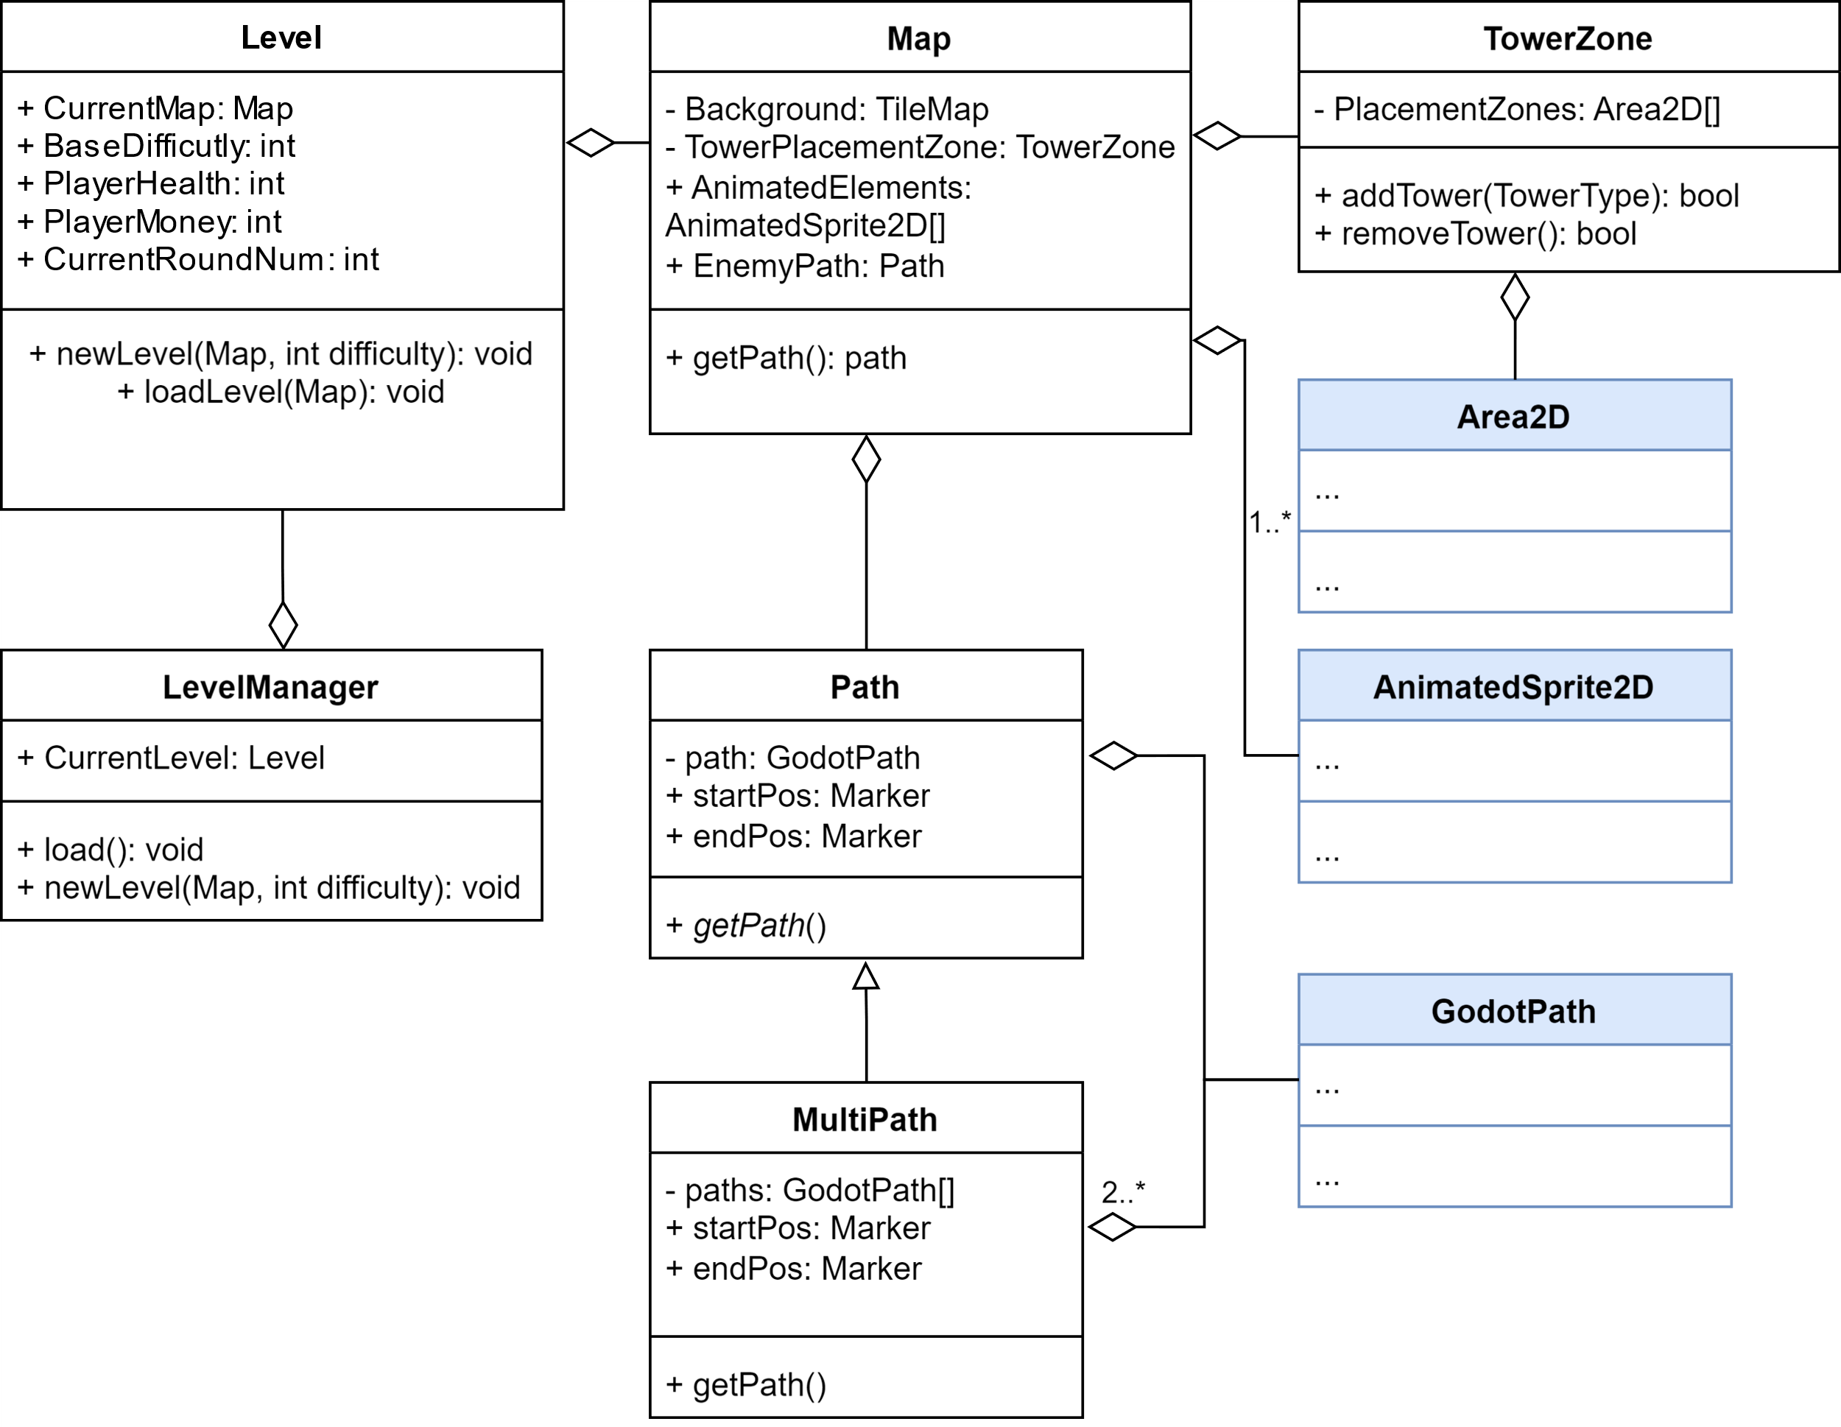
Class Diagram
Classes in blue are implemented by Godot
Austin TL2

Slide 23
Main Menu/UI
Sohan Lama TL6

Slide 24
Main Menu And UI System.
1. Introduction
Main Menu, Pause Menu, and Tower Selection System
Focus on smooth user interaction with menus to manage game flow.
2. Introducing Feature:
Allows players to start, pause, and place towers strategically during gameplay.
Critical for player control and interaction with the game.
3. Feature Priority:
Priority 1: High-priority feature
Essential for managing gameplay flow, such as starting the game, accessing tower options, pausing, and adjusting settings.
Ensures a smooth and engaging experience for players by integrating core gameplay mechanics into the UI.
Sohan Lama TL6

Slide 25
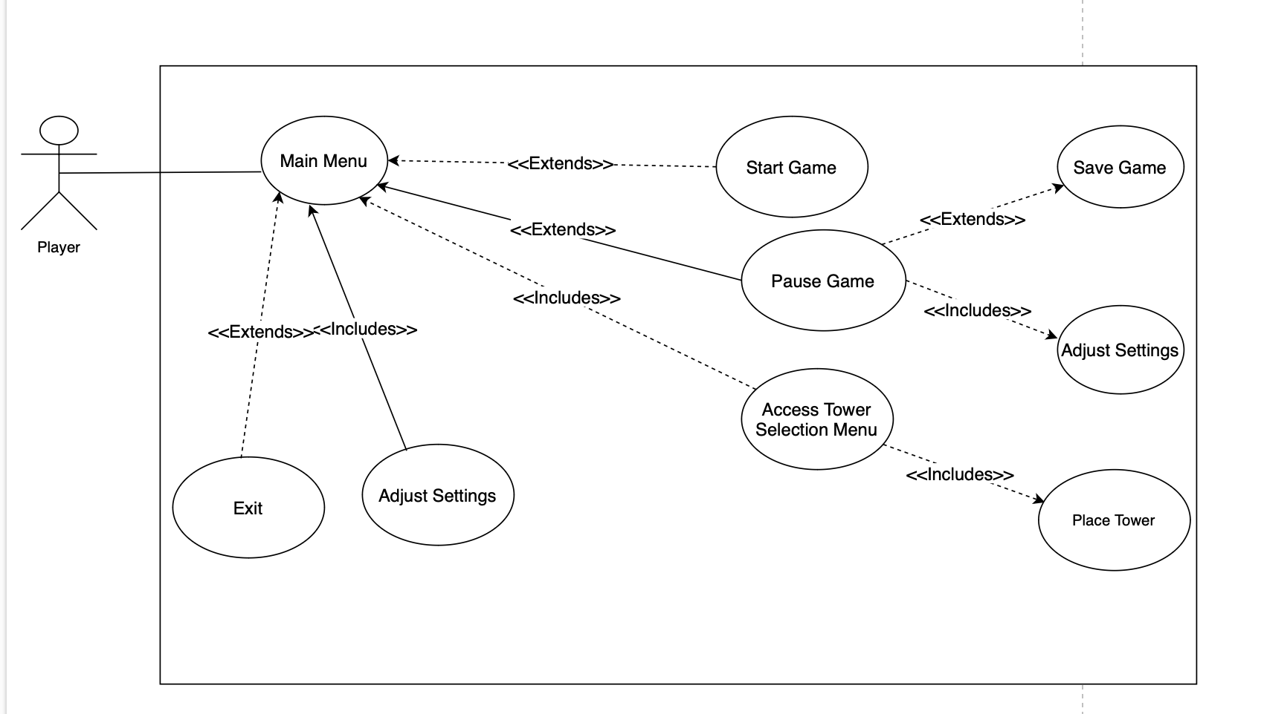
Use Case
Main Menu
Extends: Actions like Start Game and Pause Game extend from the main menu for flexible interactions.
Includes: Actions like Adjust Settings and Access Tower selection menu are included in related use cases for required functionality.
Player Interaction
Sohan Lama TL6

Slide 26
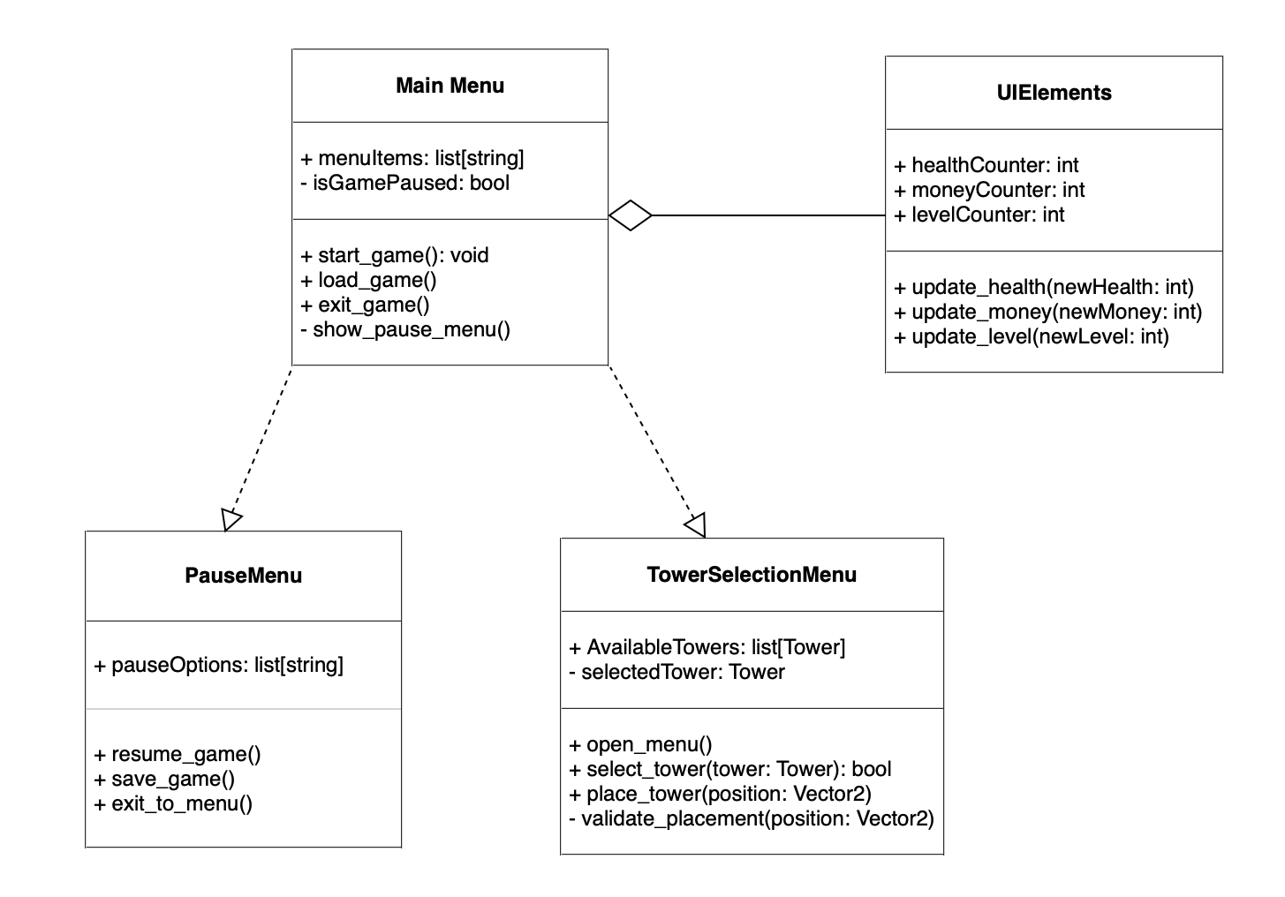
Class Diagram
Sohan Lama TL6

Slide 27
Complexity
5. Feature Complexity:
Moderate complexity
Involves integrating tower placement options, health and money tracking, and responsive UI for game state management.
While not as complex as AI or game logic, it’s crucial for providing a smooth user interface and seamless player experience.
Sohan Lama TL6

Slide 28
Round Manager
Nathan Hampton

Slide 29
Round Manager
When a Level is loaded and the user wants to start the round, the round manager needs to:
Track the round difficultly
Add enemies to the spawning queue in the level
Keep track of when the round is complete.
Increase the difficulty based on how many rounds have passed
Let the UI system know when a round is done.
Signal to the UI system if the player has completed all the rounds, or if the player has died.
Priority: Critical
Complexity: Medum complexity
Nathan Hampton

Slide 30
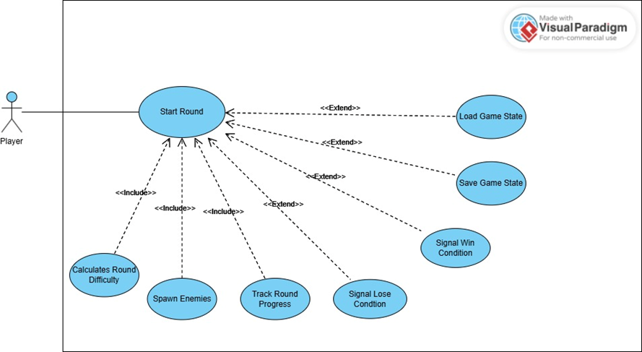
Round Manager
When a Level is loaded and the user wants to start the round, the round manager needs to
Track the round difficultly
Add enemies to the spawning queue in the level
Keep track of when the round is complete.
Increase the difficulty based on how many rounds have passed
Let the UI system know when a round is done.
Signal to the UI system if the player has completed all the rounds, or if the player has died.
Nathan Hampton

Slide 31
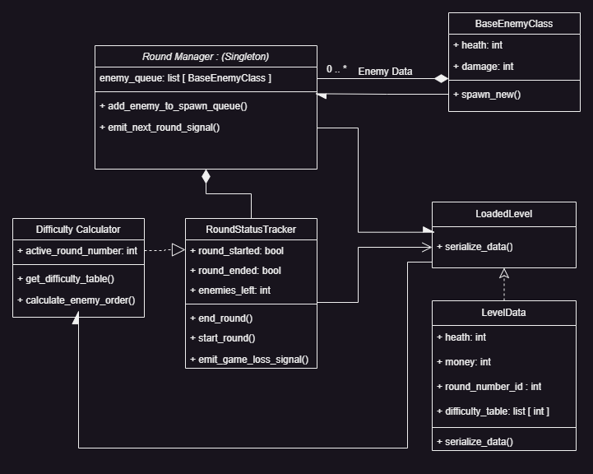
Class Diagram
Nathan Hampton

Slide 32
Enemies
Clayton TL5

Slide 33
Overview
Enemy Health
Enemy Damage
Enemy Pathing
"Chicken Split"
Chicken Spawn as extension
Clayton Slack TL5

Slide 34
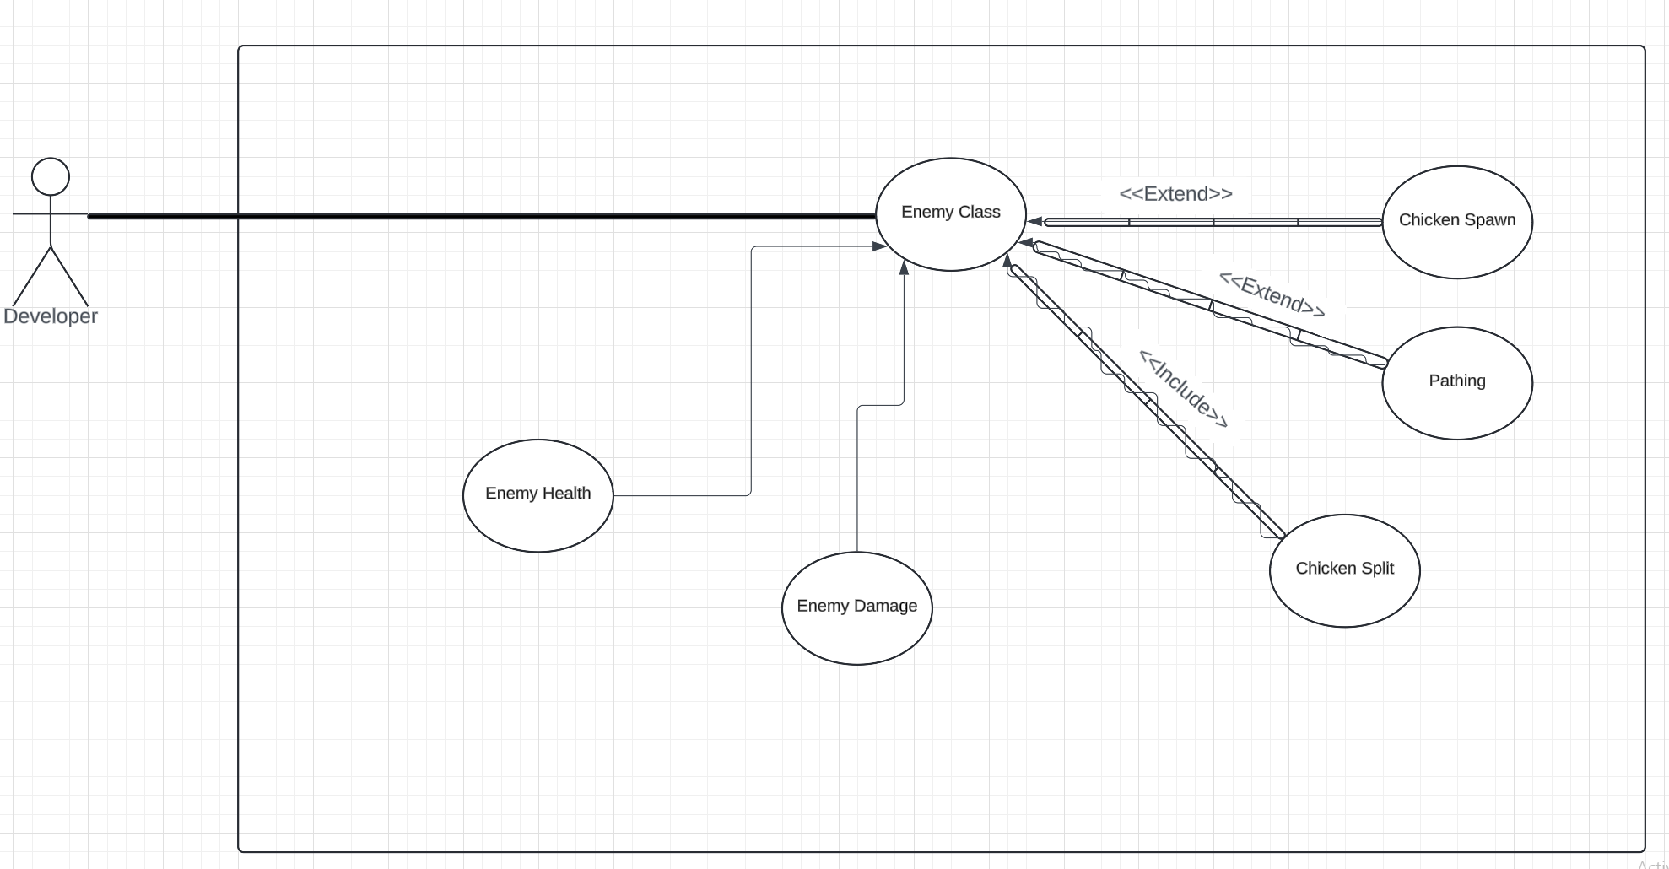
Use Case
Clayton Slack TL5

Slide 35
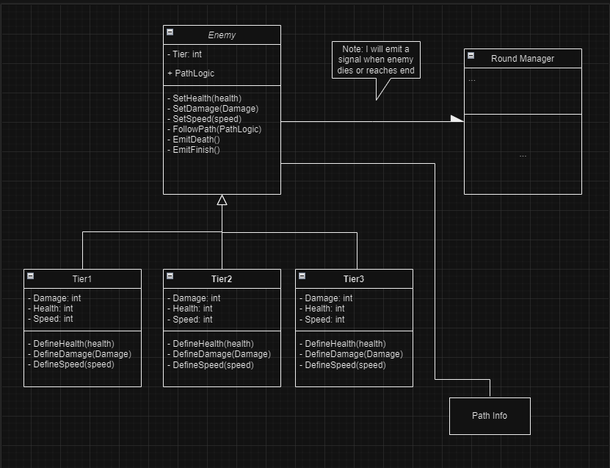
Class Diagram
Clayton Slack TL5

Slide 36
Priority and Complexity
Priority: High
Being a main game feature, the enemy class is needed for the game to function at all
Complexity level: High Medium
Assigning Health and damage to an entity is relatively straight forward, pathing and "Chicken Split" will be harder to implement, however are a part of the Godot Game Engine.
Clayton Slack TL5

Slide 37
Towers
Ankit

Slide 38
Towers
My role involves integrating tower systems to ensure our games are not only challenging but also deeply engaging for players
As the lead on the Tower System, I handle the development of critical gameplay elements that involve tower mechanics.
Primary Responsibilities:
Manage purchase_tower() for buying and placing towers.
Oversee sell_tower() and remove_tower() functions.
Handle tower mechanics for shooting and damage.
This system is at the heart of our game's strategic defense setup.
The Tower System is central to our game's fundamental operations, influencing player success and game balance, ultimately enhancing gameplay across various levels.
Priority Status:
High Priority feature
This feature is crucial for ensuring strategies to showcase how does player place the tower in level.
Ankit Paudel TL3

Slide 39
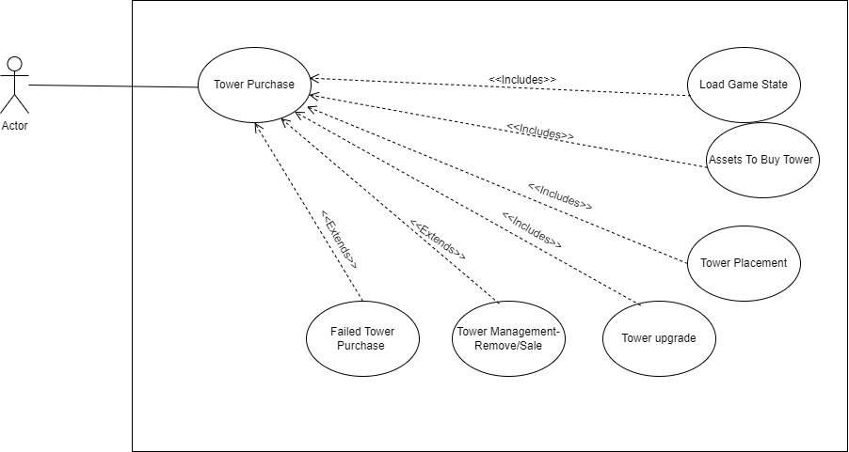
Use Case
Actor: Player
Primary Interaction: Tower Purchase
Inlcudes :Load Game State Extendes:
Assets to Buy Tower Tower Management Remove/Sell
Tower Placement Zone Failed Tower Purchase
Tower Upgrade
Ankit Paudel TL3

Slide 40
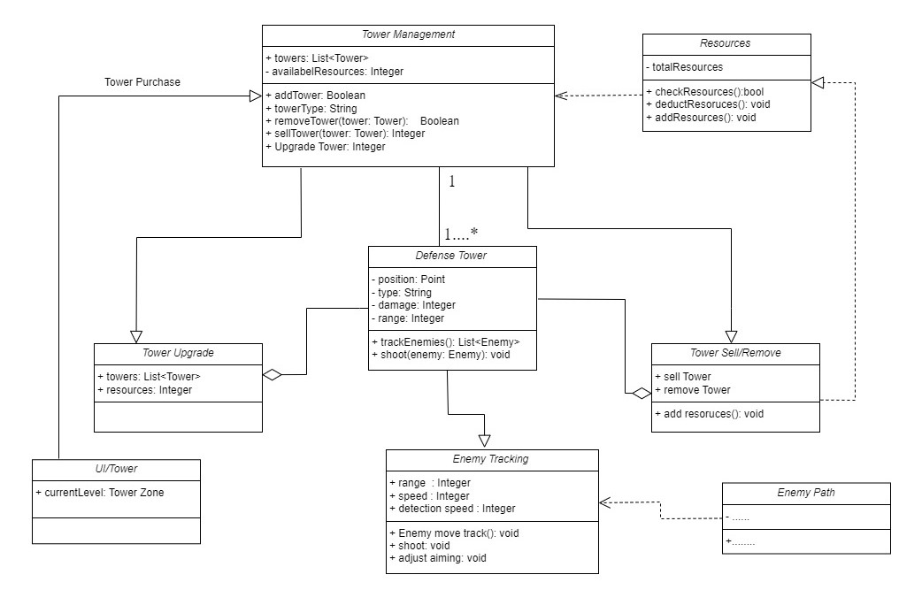
Class Diagram
Tower Management inherits from UI Tower and manages multiple Defense Towers, relying on the Resources class for financial transactions like upgrades, sales, and removals.
Defense Tower depends on Enemy Tracking, which also relies on the Enemy Path class for accurate tracking.
Tower Upgrade and Tower Sell/Remove both inherit from Tower Management but operate independently of specific Defense Towers, managing general functions directly linking to individual towers.
Resources is crucial for Tower Sell/Remove operations, managing the economics of tower transactions.
Enemy Tracking is tightly linked with Defense Tower functionality and is dependent on Enemy Path to track enemy movements effectively.
Ankit Paudel TL3

Slide 41
Complexity
Complexity Level:
High complexity:
Tower System mechanics involves, such as tower zone, tower upgrades, and strategic placement and interaction with resource management.
Managing interactions with player decisions and other game systems is often more complex.
This is because it requires the game to continuously adapt to dynamic player actions and strategies, making the gameplay engaging and responsive.
Ankit Paudel TL3

Slide 42

Questions?

